Slide 1

Unit -5
File Systems

Slide 2
FILE CONCEPTS
Files are fundamental components that allow users to store and organize data.
Key concepts related to files:
  File Definition
  File System
  File Attributes
  File Operations

Slide 3
Cont..
1.FILE DEFINITION:
A "file" is a named collection of related information that is stored on a storage medium, such as a hard drive, SSD, or other storage devices.
Files are used to organize and store data in a structured manner.
2. FILE SYSTEM:
A file system is a crucial component of an operating system that manages how data is stored, organized, and retrieved on a storage medium

Slide 4
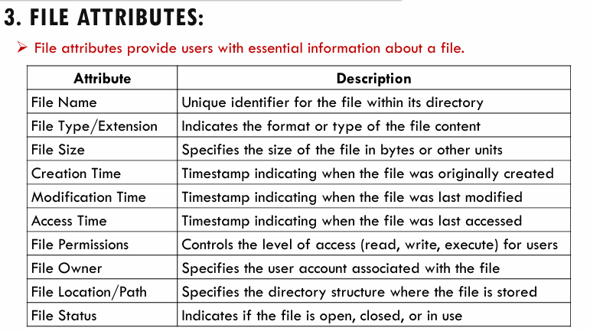
3. FILE ATTRIBUTES:

Slide 5
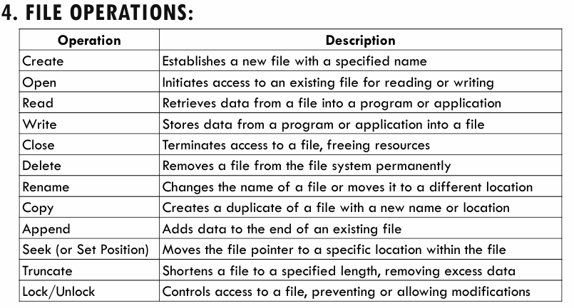
4. FILE OPERATIONS:

Slide 6
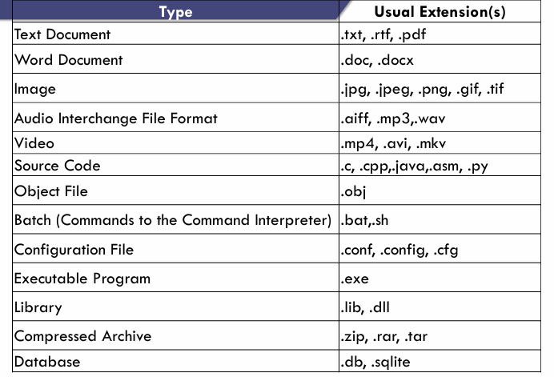
5. FILE TYPES:

Slide 7
FILE ACCESS METHODS
Files store information. When it is used, this information must be accessed and read into computer memory. The information in the file can be accessed in several ways.
Sequential Access
Direct Access
Indexed Access

Slide 8
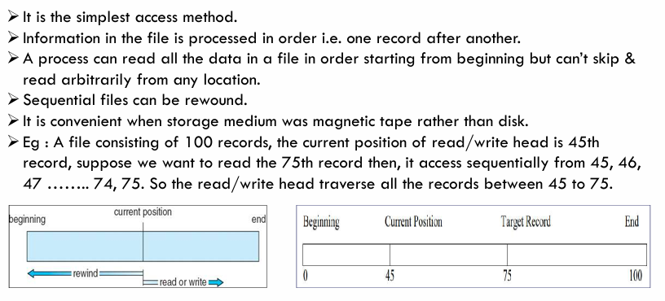
SEQUENTIAL ACCESS

Slide 9
DIRECT ACCESS
A file is made up of fixed length-logical records that allow programs to read & write records rapidly in no particular order.
This method can be used when disks are used for storing files.
This method is used in many applications e.g. database systems.
If an airline customer wants to reserve a seat on a particular flight, the reservation program must be able to access the record for that flight directly without reading the records before it.
In a direct access file, there is no restriction in the order of reading or writing.
For example, we can read block 14, then read block 50 & then write block 7 etc.
Direct access files are very useful for immediate access to large amount of information.

Slide 10
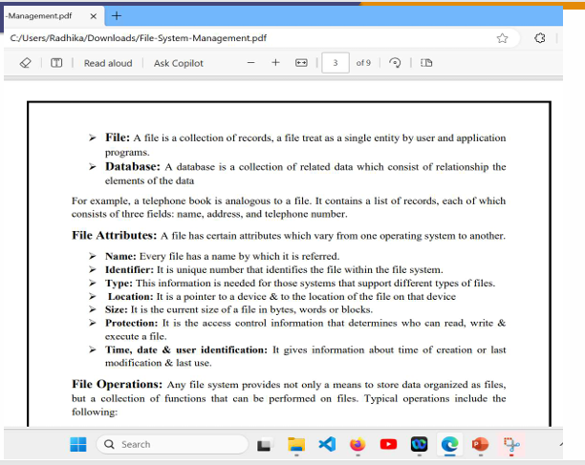
Cont..

Slide 11
INDEXED ACCESS
In this method an index is created which contains a key field and pointers to the various blocks.
To find an entry in the file for a key value, we first search the index and then use the pointer to directly access a file and find the desired entry.
With large files, the index file itself may become too large to be keep in memory.
One solution is to create an index for the index file.
The primary index file would contain pointers to secondary index files, which would point to the actual data items.

Slide 12
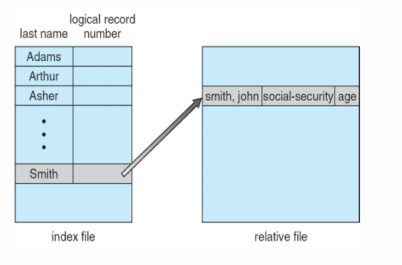
Cont..
Ex - 1

Slide 13
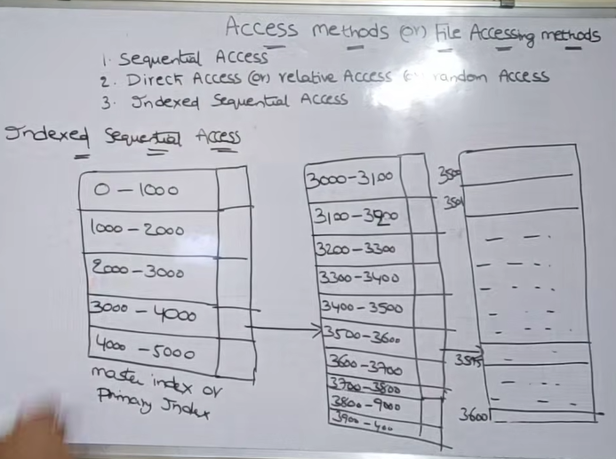
Cont..
Ex - 2

Slide 14
ALLOCATION METHODS - CONTIGUOUS
An allocation method refers to how disk blocks are allocated for files
Selection of an appropriate allocation method will significantly affect the performance :
Effective utilization of disk space
Faster Access
Contiguous allocation
Linked Allocation
Indexed Allocation

Slide 15
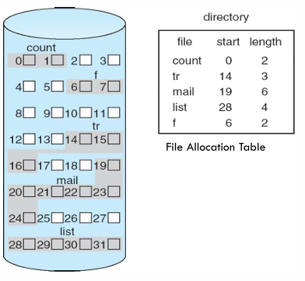
CONTIGUOUS ALLOCATION
Contiguous Allocation requires that all blocks of
a file be kept together contiguously. · Performance
is very fast, because reading successive blocks of the
same file generally requires no movement of the
disk heads, or at most one small step to the next
adjacent cylinder.
Each file occupies set of contiguous blocks
20KB File with block size
1KB -20 Blocks ➢2KB -10Blocks

Slide 16
Cont..
Advantages
1.It is simple to implement.
2.Best suited for sequential file access
Disadvantages
1.Difficult to find contiguous blocks
2.It may be difficult to have a file grow.
3. External Fragmentation (Compaction-Expensive)

Slide 17
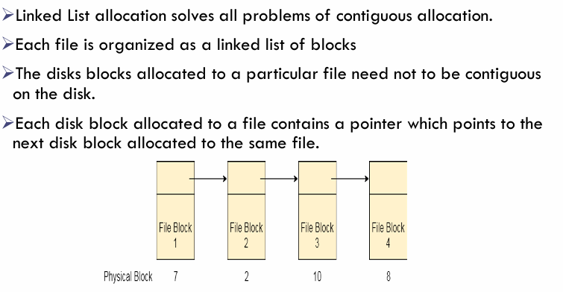
LINKED ALLOCATION

Slide 18
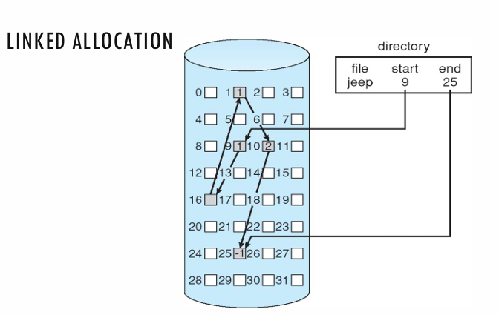
Cont..

Slide 19
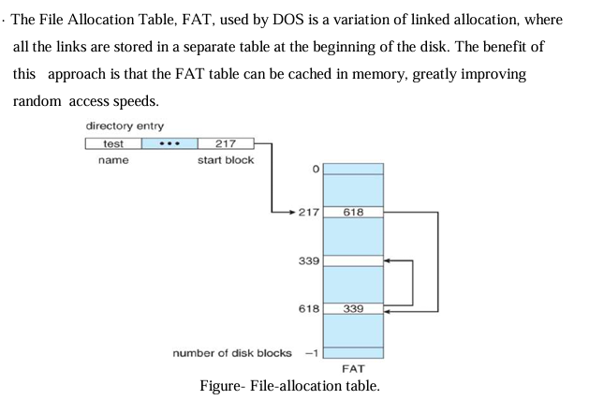
Cont..

Slide 20
Cont..
Advantages
There is no external fragmentation with linked allocation.
Any free block can be utilized in order to satisfy the file block requests.
File can continue to grow as long as the free blocks are available.
Disadvantages
Pointers require some space in the disk blocks.
Any of the pointers in the linked list must not be broken otherwise the file will get corrupted.
Need to traverse each block in order to access a specific intermediate block.

Slide 21
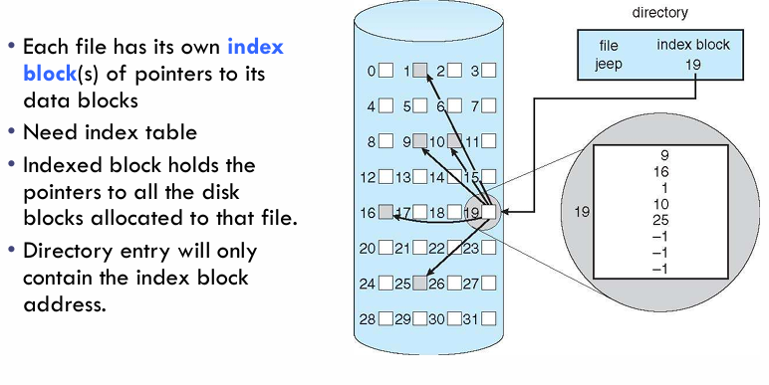
INDEXED ALLOCATION

Slide 22
Cont..
Linked Scheme - An index block is one disk block, which can be read and written in a single disk operation. The first index block contains some header information, the first N block addresses, and if necessary a pointer to additional linked index blocks.
Multi-Level Index - The first index block contains a set of pointers to secondary index blocks, which in turn contain pointers to the actual data blocks.
Combined Scheme - This is the scheme used in UNIX inodes, in which the first 12 or so data block pointers are stored directly in the inode, and then singly, doubly, and triply indirect pointers provide access to more data blocks as needed. (See below.) The advantage of this scheme is that for small files ( which many are ), the data blocks are readily accessible ( up to 48K with 4K block sizes ); files up to about 4144K ( using 4K blocks ) are accessible with only a single indirect block ( which can be cached ), and huge files are still accessible using a relatively small number of disk accesses ( larger in theory than can be addressed by a 32-bit address, which is why some systems have moved to 64-bit file pointers. )

Slide 23
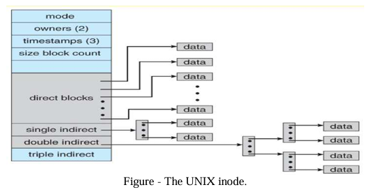
Cont..

Slide 24
Cont..
Advantages
1.Supports both sequential and random access
2.A bad data block causes the lost of only that block.
3.No external fragmentation
4.Allows the files to grow in size
Disadvantages
1.A bad index block could cause the lost of entire file.
2.Size of a file depends upon the number of pointers, a index block can hold.

Slide 25
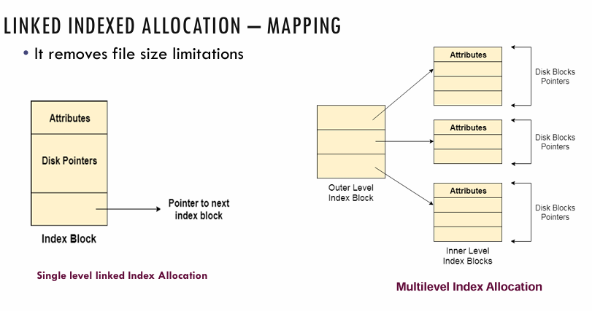
LINKED INDEXED ALLOCATION – MAPPING

Slide 26
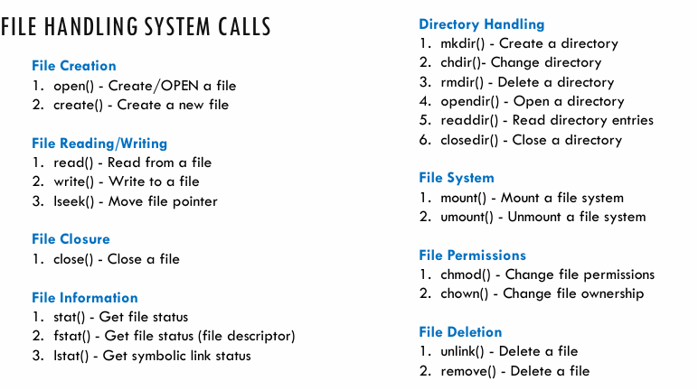
FILE HANDLING SYSTEM CALLS

Slide 27
FILE SYSTEM METADATA
File System metadata refers to information about files and directories
It includes file attributes, permissions, ownership, and location.
Metadata is stored separately from file contents.
Types of Metadata:
1. File Attributes: filename, extension, size, creation/modification timestamps.
2. File Permissions: read, write, execute permissions for owner, group, others.
3. File Ownership: owner ID, group ID.
4. File Location: directory path, disk block numbers.

Slide 28
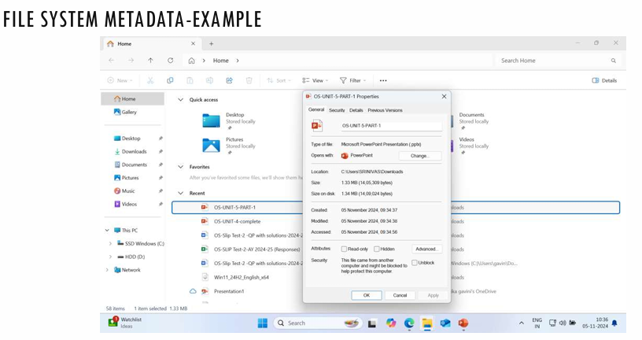
Cont..

Slide 29
FILE SYSTEM SYSTEM METADATA
Purpose of Metadata:
1. Efficient file organization and access
2. Security and access control
3. File system integrity and recovery.
Examples File Systems:
1. Windows OS: NTFS (New Technology File System)
2. UNIX: UFS
3. Linux: ext2/ext3/ext4 (Extended File System)

Slide 30
FILE SYSTEM METADATA-INODE
An inode contains metadata about a file or directoryStructure
The inode structure varies depending on the file system.
Simplified representation of Inode:
Inode
{
uint32_t i_mode; // File type and permissions
uint32_t i_uid; // Owner ID
uint32_t i_gid; // Group ID
uint32_t i_size; // File size
uint32_t i_atime; // Access time
uint32_t i_mtime; // Modification time
uint32_t i_ctime; // Creation time
uint32_t i_blksize;// Block size
uint32_t i_blocks; // Number of blocks // ...}

Slide 31
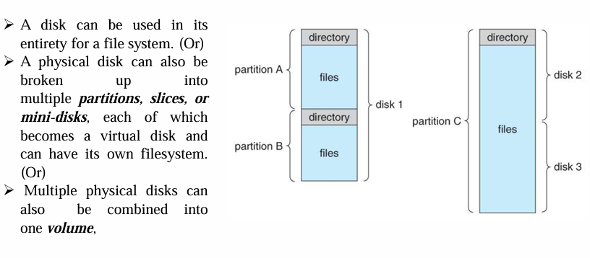
DIRECTORY STRUCTURES: STORAGE STRUCTURE

Slide 32
DIRECTORY OPERATIONS
Directory operations to be supported include:
  Search for a file
  Create a file - add to the directory
  Delete a file - erase from the directory
  List a directory - possibly ordered in different ways.
  Rename a file - may change sorting order
  Traverse the file system.

Slide 33
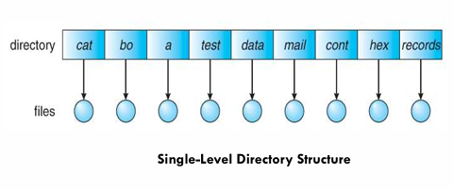
TYPES OF DIRECTORY STRUCTURES: Single-Level Directory
Simple to implement, but each file must have a unique name.
Draw Backs:
Naming Problem
·Grouping Problem

Slide 34
Two-Level Directory
Each user gets their own directory space.
File names only need to be unique within a given user's directory.
A master file directory is used to keep track of each user’s directory, and must be maintained when users are added to or removed from the system.
A separate directory is generally needed for system ( executable ) files. · Systems may or may not allow users to access other directories besides their own
If access to other directories is allowed, then provision must be made to specify the directory being accessed.
If access is denied, then special consideration must be made for users to run programs located in system directories. A search path is the list of directories in which to search for executable programs, and can be set uniquely for each user.

Slide 35
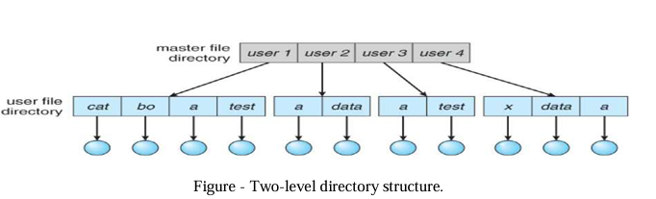
Cont..

Slide 36
Tree-Structured Directories
An obvious extension to the two-tiered directory structure, and the one with which we are all most familiar.
Each user / process has the concept of a current directory from which all ( relative ) searches take place.
Files may be accessed using either absolute pathnames ( relative to the root of the tree ) or relative pathnames ( relative to the current directory. )
Directories are stored the same as any other file in the system, except there is a bit that identifies them as directories, and they have some special structure that the OS understands.
One question for consideration is whether or not to allow the removal of directories that are not empty - Windows requires that directories be emptied first, and UNIX provides an option for deleting entire sub-trees.

Slide 37
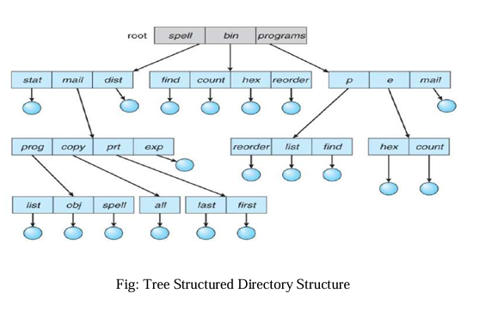
Cont..

Slide 38
Acyclic-Graph Directories
When the same files need to be accessed in more than one place in the directory structure ( e.g. because they are being shared by more than one user / process ), it can be useful to provide an acyclic-graph structure. ( Note the directed arcs from parent to child. ) · UNIX provides two types of links for implementing the acyclic-graph structure. ( See "man ln" for more details. )
A hard link ( usually just called a link ) involves multiple directory entries that both refer to the same file. Hard links are only valid for ordinary files in the same file system.
A symbolic link that involves a special file, containing information about where to find the linked file. Symbolic links may be used to link directories and/or files in other file systems, as well as ordinary files in the current file system.
Windows only supports symbolic links, termed shortcuts.
Hard links require a reference count, or link count for each file, keeping track of how many directory entries are currently referring to this file. Whenever one of the references is removed the link count is reduced, and when it reaches zero, the disk space can be reclaimed.
For symbolic links there is some question as to what to do with the symbolic links when the original file is moved or deleted:

Slide 39
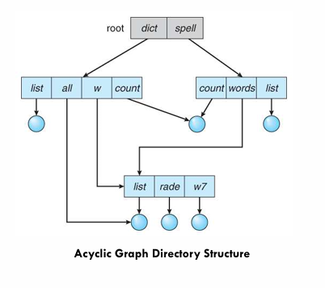
Cont..
One option is to find all the symbolic links and adjust them also.
Another is to leave the symbolic links dangling, and discover that they are no longer valid the next time they are used.
What if the original file is removed, and replaced with another file having the same name before the symbolic link is next used?

Slide 40
General Graph Directory
If cycles are allowed in the graphs, then several problems can arise:
Search algorithms can go into infinite loops. One solution is to not follow links in search algorithms. ( Or not to follow symbolic links, and to only allow symbolic links to refer to directories. )
Sub-trees can become disconnected from the rest of the tree and still not have their reference counts reduced to zero. Periodic garbage collection is required to detect and resolve this problem. ( chkdsk in DOS and fsck in UNIX search for these problems, among others, even though cycles are not supposed to be allowed in either system. Disconnected disk blocks that are not marked as free are added back to the file systems with made-up file names, and can usually be safelydeleted.)

Slide 41
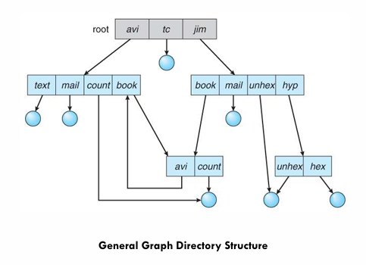
Cont..

Slide 42
FILE SYSTEM PERFORMANCE: CACHING
Since the access to disk is much slower than access to memory, many file systems have been designed with various optimizations to improve performance.
Caching
The most common technique used to reduce disk access time is the block cache or buffer cache.
The most common algorithm for cache works in such a way that if a disk access is initiated, the cache is checked first to see if the disk block is present.
If yes then the read request can be satisfied without a disk access else the disk block is copied to cache first and then the read request is processed.

Slide 43
FILE SYSTEM PERFORMANCE: CACHING OPTIMIZATIONS
Block Read Ahead
Another technique to improve file-system performance is to try to get blocks into the cache before they are needed to increase the hit rate. This works only when files are read sequentially. When a file system is asked for block 'k' in the file it does that and then also checks before hand if 'k+1' is available if not it schedules a read for the block k+1 thinking that it might be of use later.

Slide 44
FILE SYSTEM PERFORMANCE: CACHING OPTIMIZATIONS
Reducing disk arm motion
Another way to increase file-system performance is by reducing the disk-arm motion by putting blocks that are likely to be accessed in sequence close to each other, preferably in the same cylinder.

Slide 45
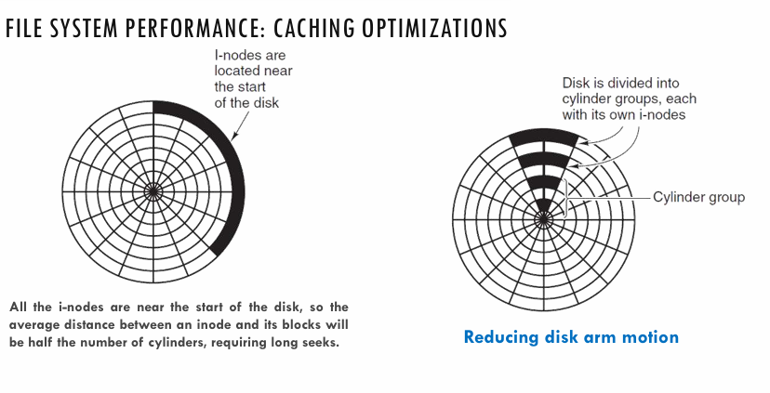
Cont..

Slide 46
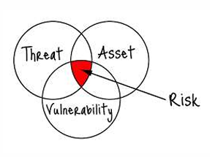
OS SECURITY
Operating System security refers to the measures and practices implemented to protect an operating system from threats, attacks, and unauthorized access.
The primary goal of OS security is to ensure the confidentiality, integrity, and availability of data and system resources.
Terminology
Intruders (crackers) attempt to breach security
Threat is a potential security violation
Attack is an attempt to breach security
Attack can be accidental or malicious
Easier to protect against accidental than malicious misuse

Slide 47
SECURITY VIOLATION CATEGORIES
Some of the most common types of security violations are as follows:
Breach of confidentiality- Unauthorized reading of data
Breach of integrity- Unauthorized modification of data
Breach of availability- Unauthorized destruction of data
Theft of service- Unauthorized use of resources
Denial of service (DOS)- Prevention of legitimate use

Slide 48
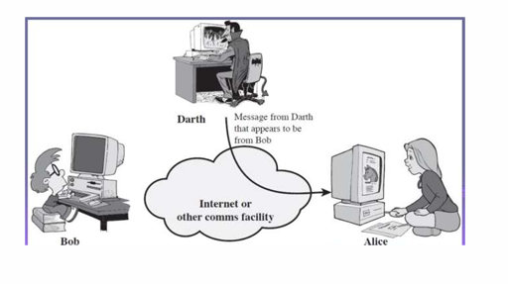
TYPES OF SECURITY ATTACKS
Masquerading (breach authentication)
  Pretending to be an authorized user to escalate privileges

Slide 49
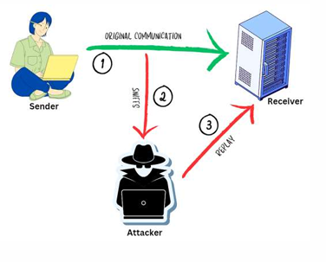
Cont..
Replay attack
  As is or with message modification

Slide 50
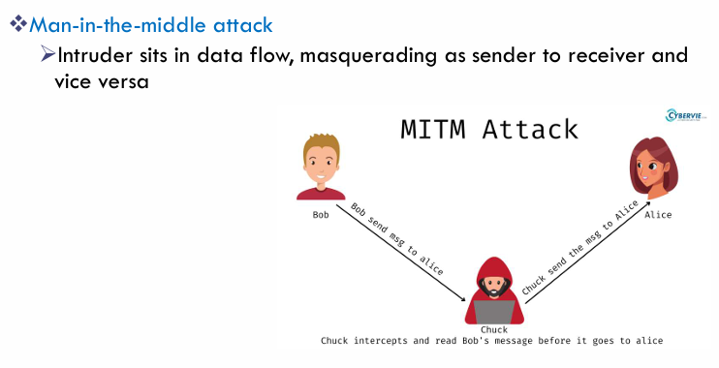
Cont..

Slide 51
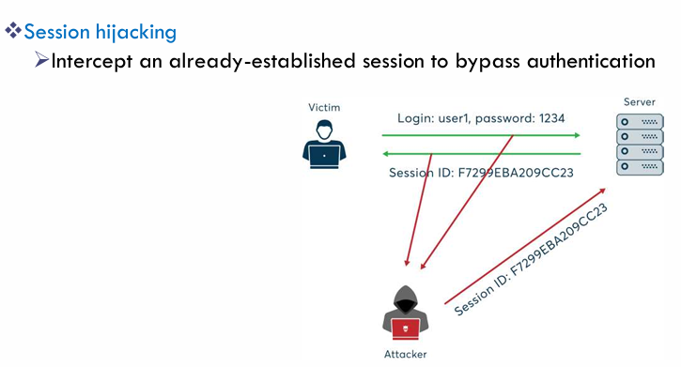
Cont..

Slide 52
LEVELS OF SECURITY MEASURES
Security must occur at four levels to be effective:
Physical
  Data centers, servers, connected terminals
Human
  Avoid social engineering, phishing, dumpster diving
Operating System
  Protection mechanisms, debugging
Network
  Intercepted communications, interruption, DOS
Security is as weak as the weakest link in the chain

Slide 53
PROGRAM THREATS
Program threats are malicious tasks performed by user programs. There are many variations of program threats:
Trojan Horse
  Code segment that misuses its environment
  Up to 80% of spam is delivered by spyware-infected systems
Zeus Trojan (2007)Also known as Zbot, this Trojan horse is one of the most notorious Trojans. How it worked:
Spread through phishing emails or drive-by downloads
Installed malware on victim's computer
Stole sensitive information: - Login credentials (banking, email, etc.) - Credit card numbers - Personal data
Allowed remote access to infected computer

Slide 54
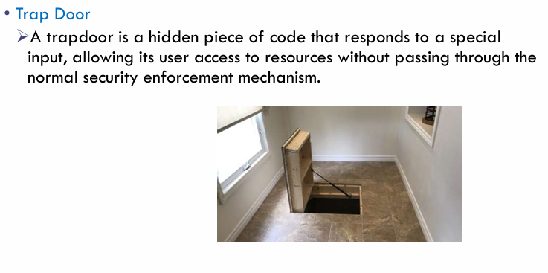
Cont..

Slide 55
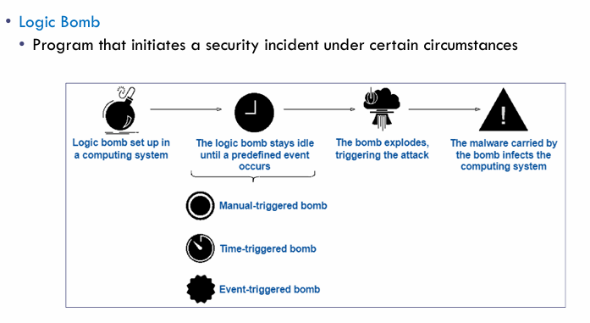
Cont..

Slide 56
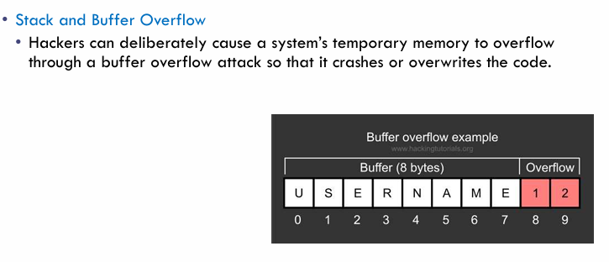
Cont..

Slide 57
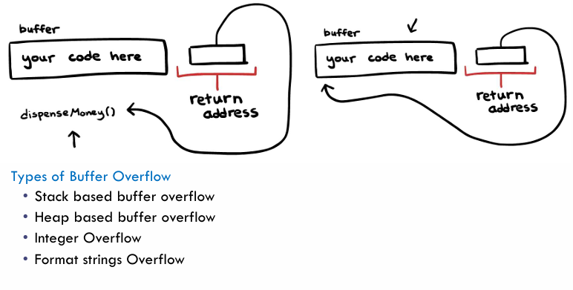
Cont..

Slide 58
Cont..
Viruses
  Code fragment embedded in legitimate program
  Self-replicating, designed to infect other computers
  Usually borne via email or as a macro
Worms:
Definition: Worms are self-replicating malicious programs that can spread across networks and systems without user intervention.

Slide 59
THE THREAT CONTINUES
Attacks are still common and continue to occur.
Attacks moved over time from science experiments to tools of organized attacks
Targeting specific companies
Creating botnets to use as tool for spam and DDOS delivery
Keystroke logger to grab passwords, credit card numbers
Why is Windows the target for most attacks?
  Most common
  Monoculture considered harmful

Slide 60
SYSTEM AND NETWORK THREATS
Some systems “open” rather than secure by default
Reduce attack surface (Transparency, Community Support and Customization)
Network threats harder to detect, prevent
Protection systems weaker
No physical limits once system attached to internet
Even determining location of connecting system difficult
IP address is only knowledge

Slide 61
Cont..
Port scanning
Automated attempt to connect to a range of ports on one or a range of IP addresses
Detection of answering service protocol
Detection of OS and version running on system
nmap scans all ports in a given IP range for a response
nessus has a database of protocols and bugs (and exploits) to apply against a system
Frequently launched from zombie systems
To decrease trace-ability

Slide 62
DEFENCE: OVERVIEW, LOGGING, AUDITING, AND RECOVERY
Logging and Auditing:
Security Event Logging: Enable comprehensive logging of security events. Includes system calls, file accesses, user logins etc.
Centralized Logging:
  Centralizing logs to a secure, remote server prevents tampering.
  This ensures that even if a rootkit compromises local logs, a copy of the logs is preserved externally.
Regular Auditing: To identify any unusual system behavior like repeated failed login attempts.
Automated tools are available.

Slide 63
Cont..
Recovery:
Backup Systems: Implement regular and secure backups of critical system files
Incident Response Plan: Develop and document an incident response plan that includes
  procedures for isolating affected systems
  removing the rootkit and
  restoring from backups.
Forensic Analysis: To understand how the rootkit entered the system, what changes it made, and how to prevent future occurrences

Slide 64
.
THANK YOU
Mr.B.Sai Kumar
Assistant Professor CSE Department

